Slide 1


Inflectional Morphology:Understanding Grammatical Variations
Guided By:
Dr.T.Devi
Presented By:
V.Sireesha - 192472208

Slide 2
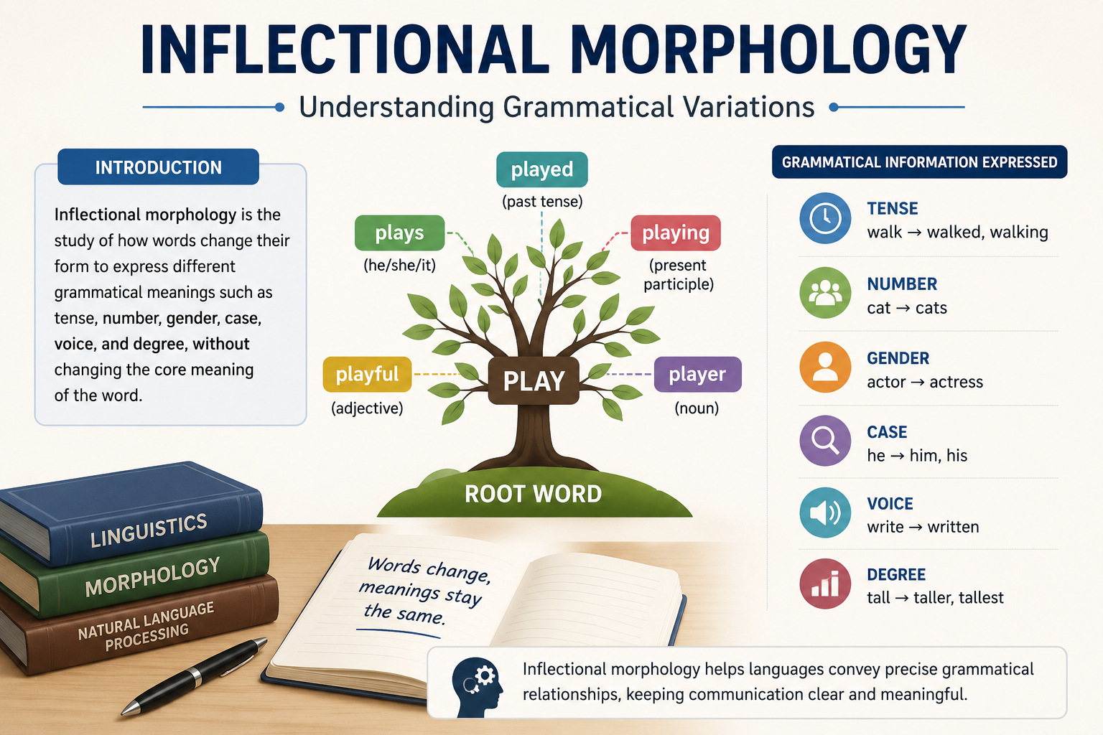
Introduction
Inflectional morphology is the study of how words change their form to express grammatical information.
It changes the form of a word without changing its basic meaning.
These changes show tense, number, person, gender, and case.
It is an important part of Natural Language Processing (NLP).
Example
play → plays → played → playing
cat → cats
book → books

Slide 3
Grammatical Variations
Types of Inflection
1. Tense
walk → walked
play → playing
2. Number
cat → cats
child → children
3. Person
I play
He plays
4. Case
he → him
she → her

Slide 4
Characteristics of Inflectional Morphology
Features
Does not create a new word.
Only changes the grammatical form.
Meaning of the root word remains the same.
Helps identify grammatical relationships.
Common in almost every language.
Example
Root Word | Inflected Form
Play | Played
Book | Books
Write | Writing
Eat | Eats

Slide 5
Applications of Inflectional Morphology
Real-World Applications
Machine Translation
Example: Google Translate
Speech Recognition
Example: Siri, Alexa
Spell & Grammar Checking
Example: Grammarly, Microsoft Word
Search Engines
Example: Google Search
Chatbots
Example: ChatGPT
Text Processing
Used in document analysis and language understanding.

Slide 6
Result
Inflectional Morphology is essential for understanding grammatical structures in language.
It improves the accuracy of NLP applications like machine translation, chatbots, grammar checking, and speech recognition.
It enables computers to process human language more effectively.
Studied the concept of Inflectional Morphology.
Understood grammatical variations such as tense, number, person, and case.
Learned how word forms change without changing their meaning.
Explored its applications in NLP systems.

Slide 7
Real-World Example
Grammarly
Input:
She walk to school every day.
NLP Analysis:
Root Word: walk
Subject: She (Third Person Singular)
Correct Inflection: walks
Output:
She walks to school every day.

Slide 8
THANK YOU…..

